Slide 1



SalesDashboard
View in Power BI
Last data refresh:
01-12-2020 01:04:38 India Standard Time
Downloaded at:
01-12-2020 01:17:35 India Standard Time

Slide 2
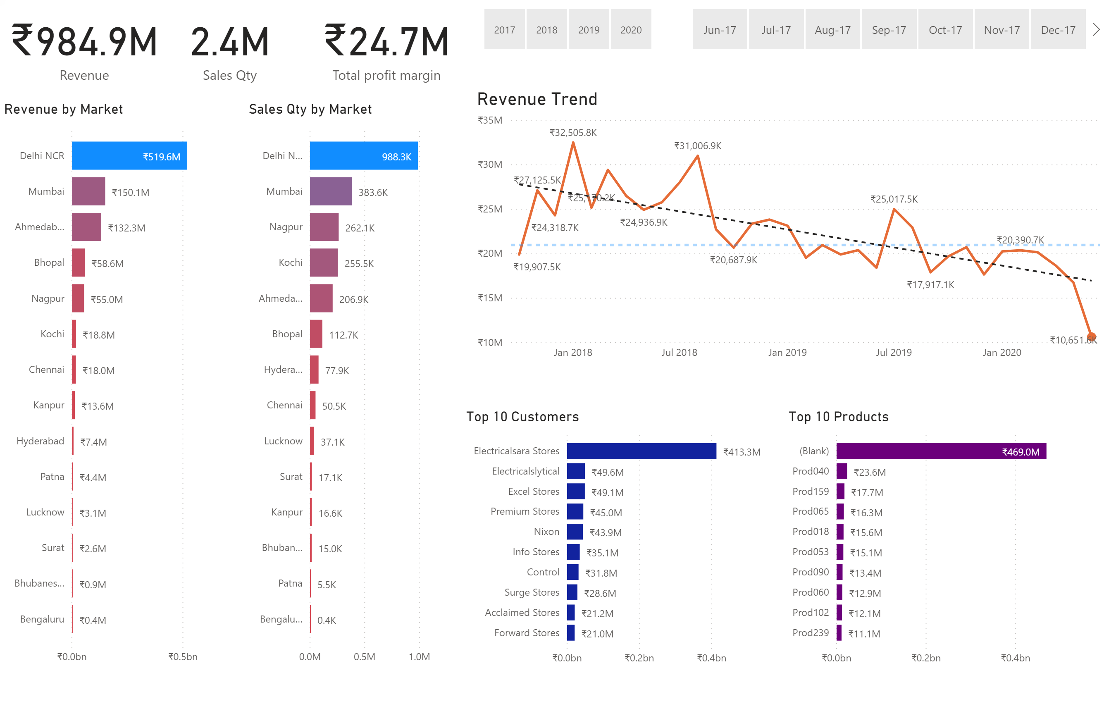

Slide 3
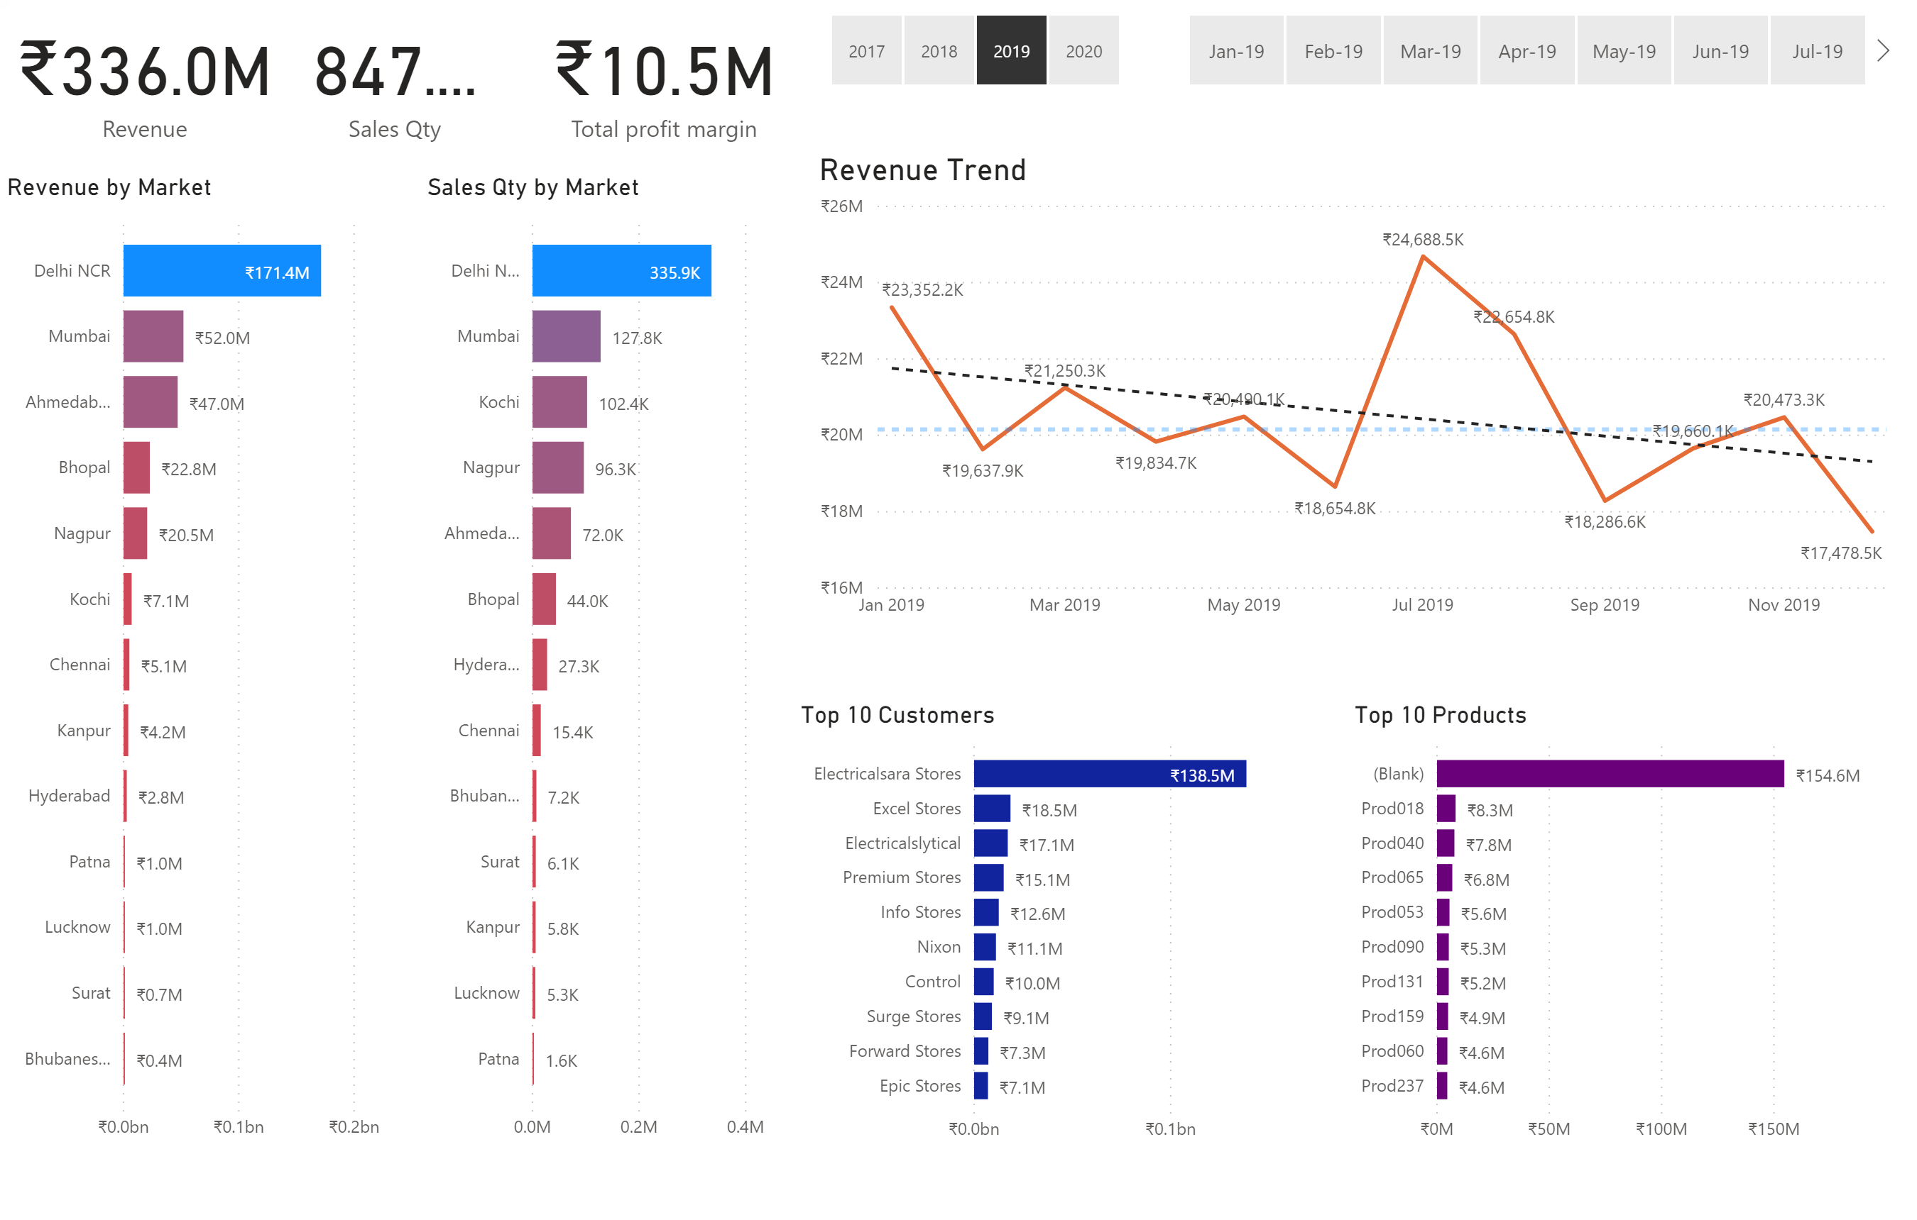

Slide 4
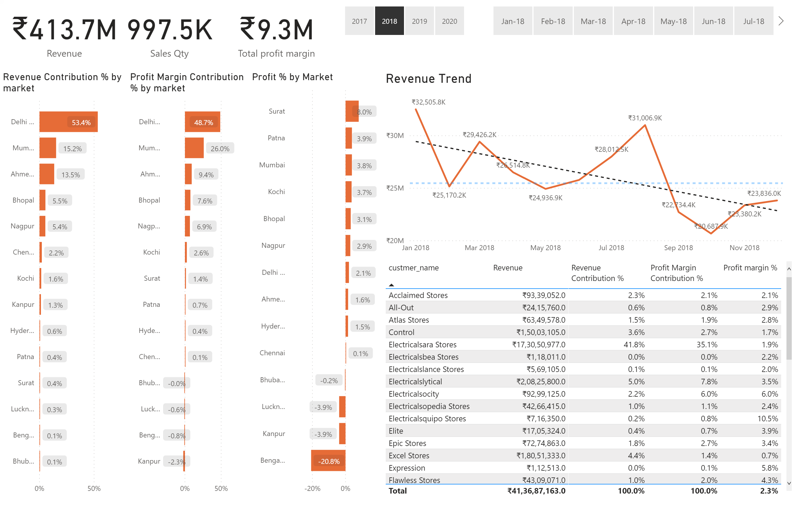

Slide 5
